Slide 1
^{DSI Capstone} ^{10/03 Weekly Update}
Oct 6, 2022

Slide 2
Agenda
1
From Last Week
2
EDA: Government perspective
3
EDA: Long distance traveller perspective
4
EDA: Existing infrastructure perspective
5
Next Steps

Slide 3
From Last Week
1
Action items:
Gather data & perform deep dive EDA on 3 perspectives
Government perspective
Long-distance traveller perspective
Existing infrastructure perspective
Start to select models/algorithms if time remains

Slide 4
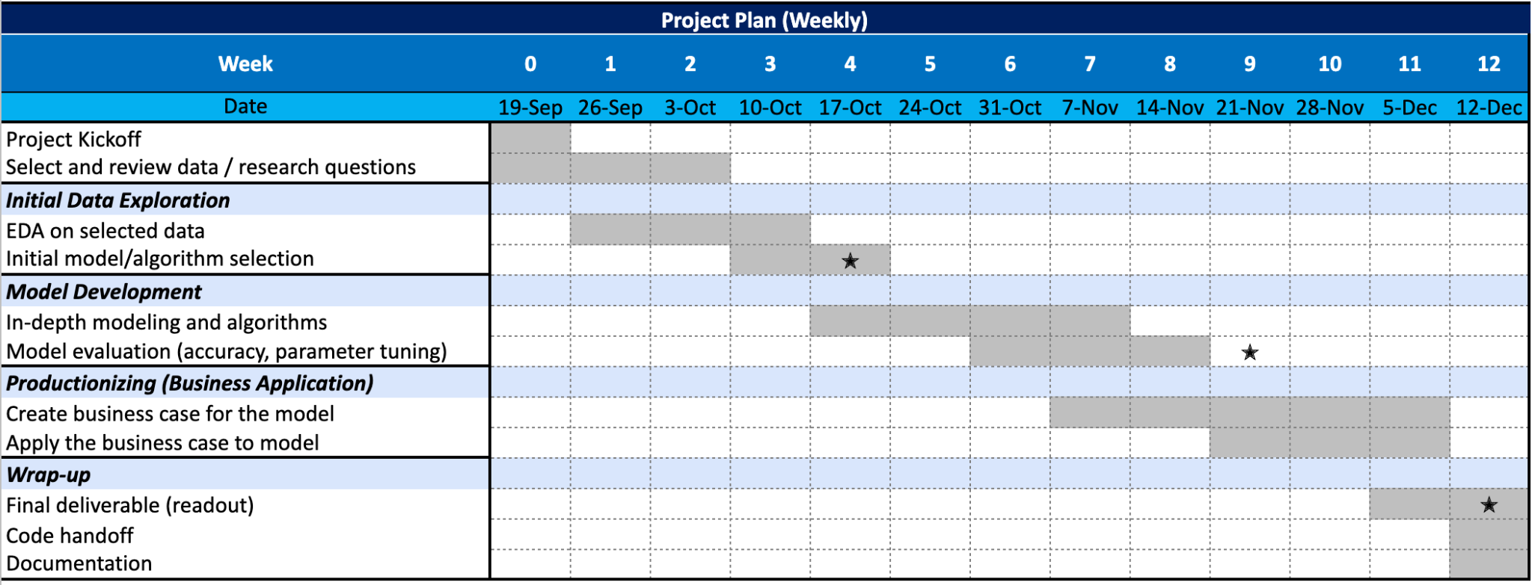
From Last Week: Timeline
1

Slide 5
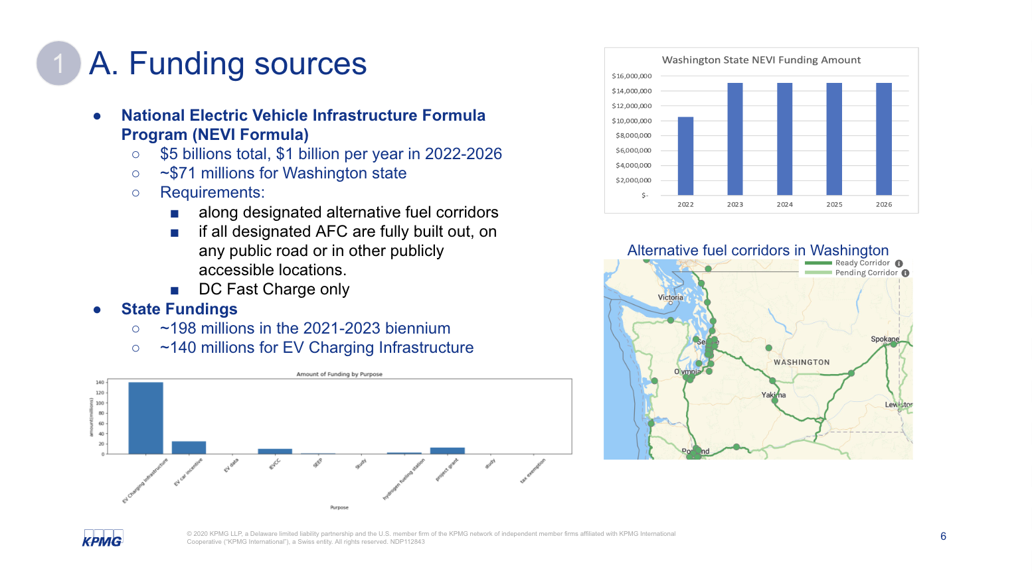
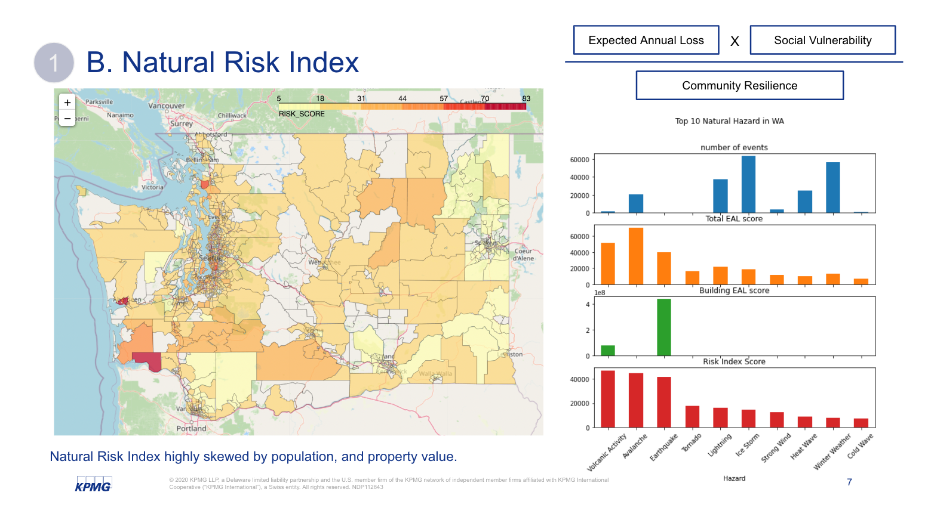
EDA: Government perspective
2
Regarding government support, fundings provided by federal, state, or other organizations may affect the optimal decision on placing EV supplemental equipment. Risk of natural hazards and expected property loss in the area are also major concerns.
A
Funding sources
B
Natural Hazards

Slide 6
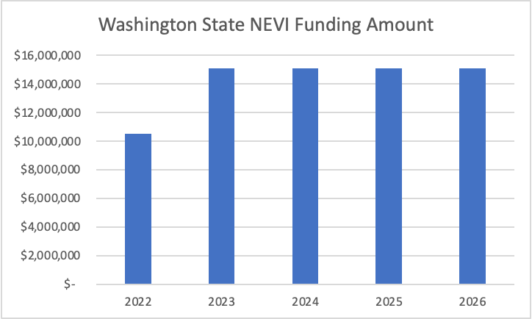
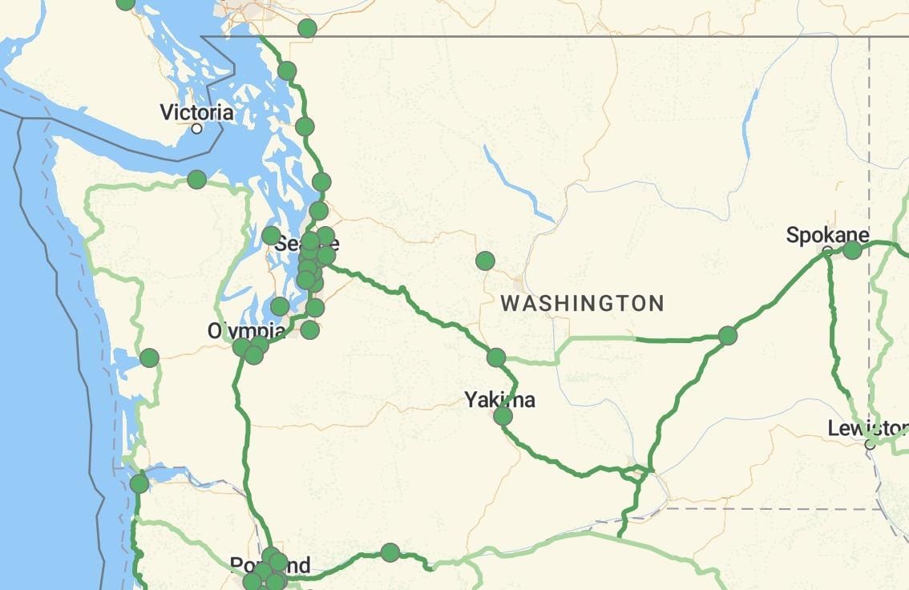

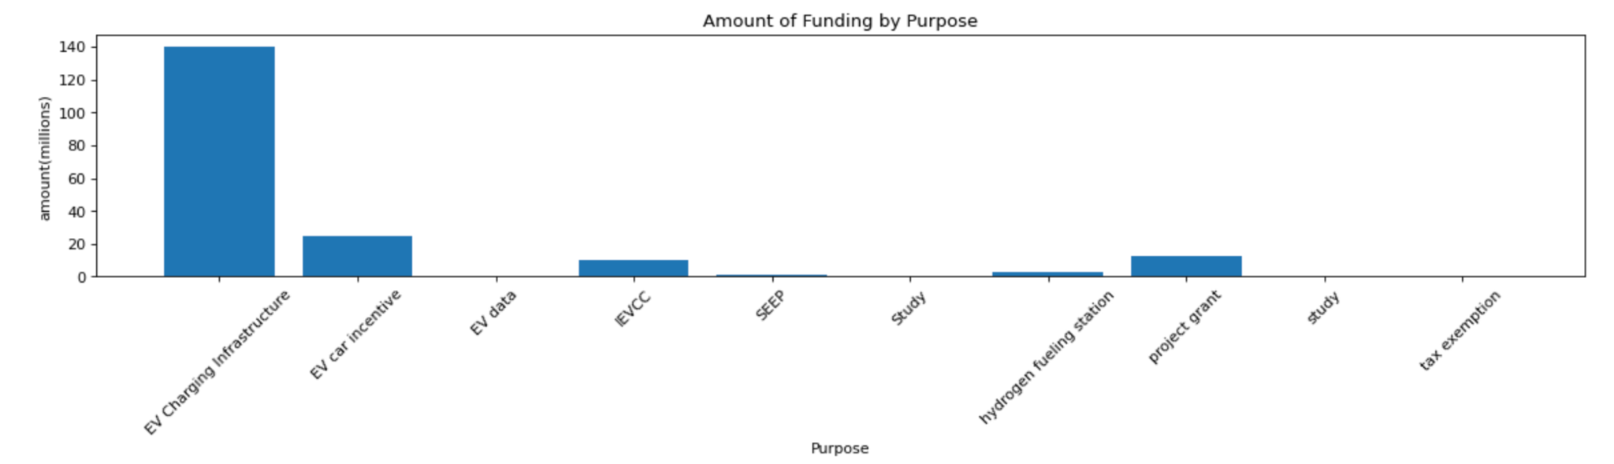
A. Funding sources
2
Federal: National Electric Vehicle Infrastructure Formula Program (NEVI Formula)
$5 billions total, $1 billion per year in 2022-2026
~$71 millions for Washington state
Requirements:
along designated alternative fuel corridors
if all designated AFC are fully built out, on any public road or in other publicly accessible locations.
Level 3 DC Fast Charge only
State Fundings
~198 millions in the 2021-2023 biennium
~140 millions for EV Charging Infrastructure
Alternative fuel corridors in Washington
Notes:
Level 2 $5,500
DC Fast Charge $40,000

Slide 7
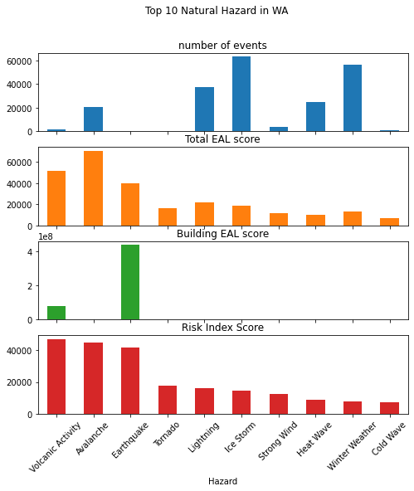
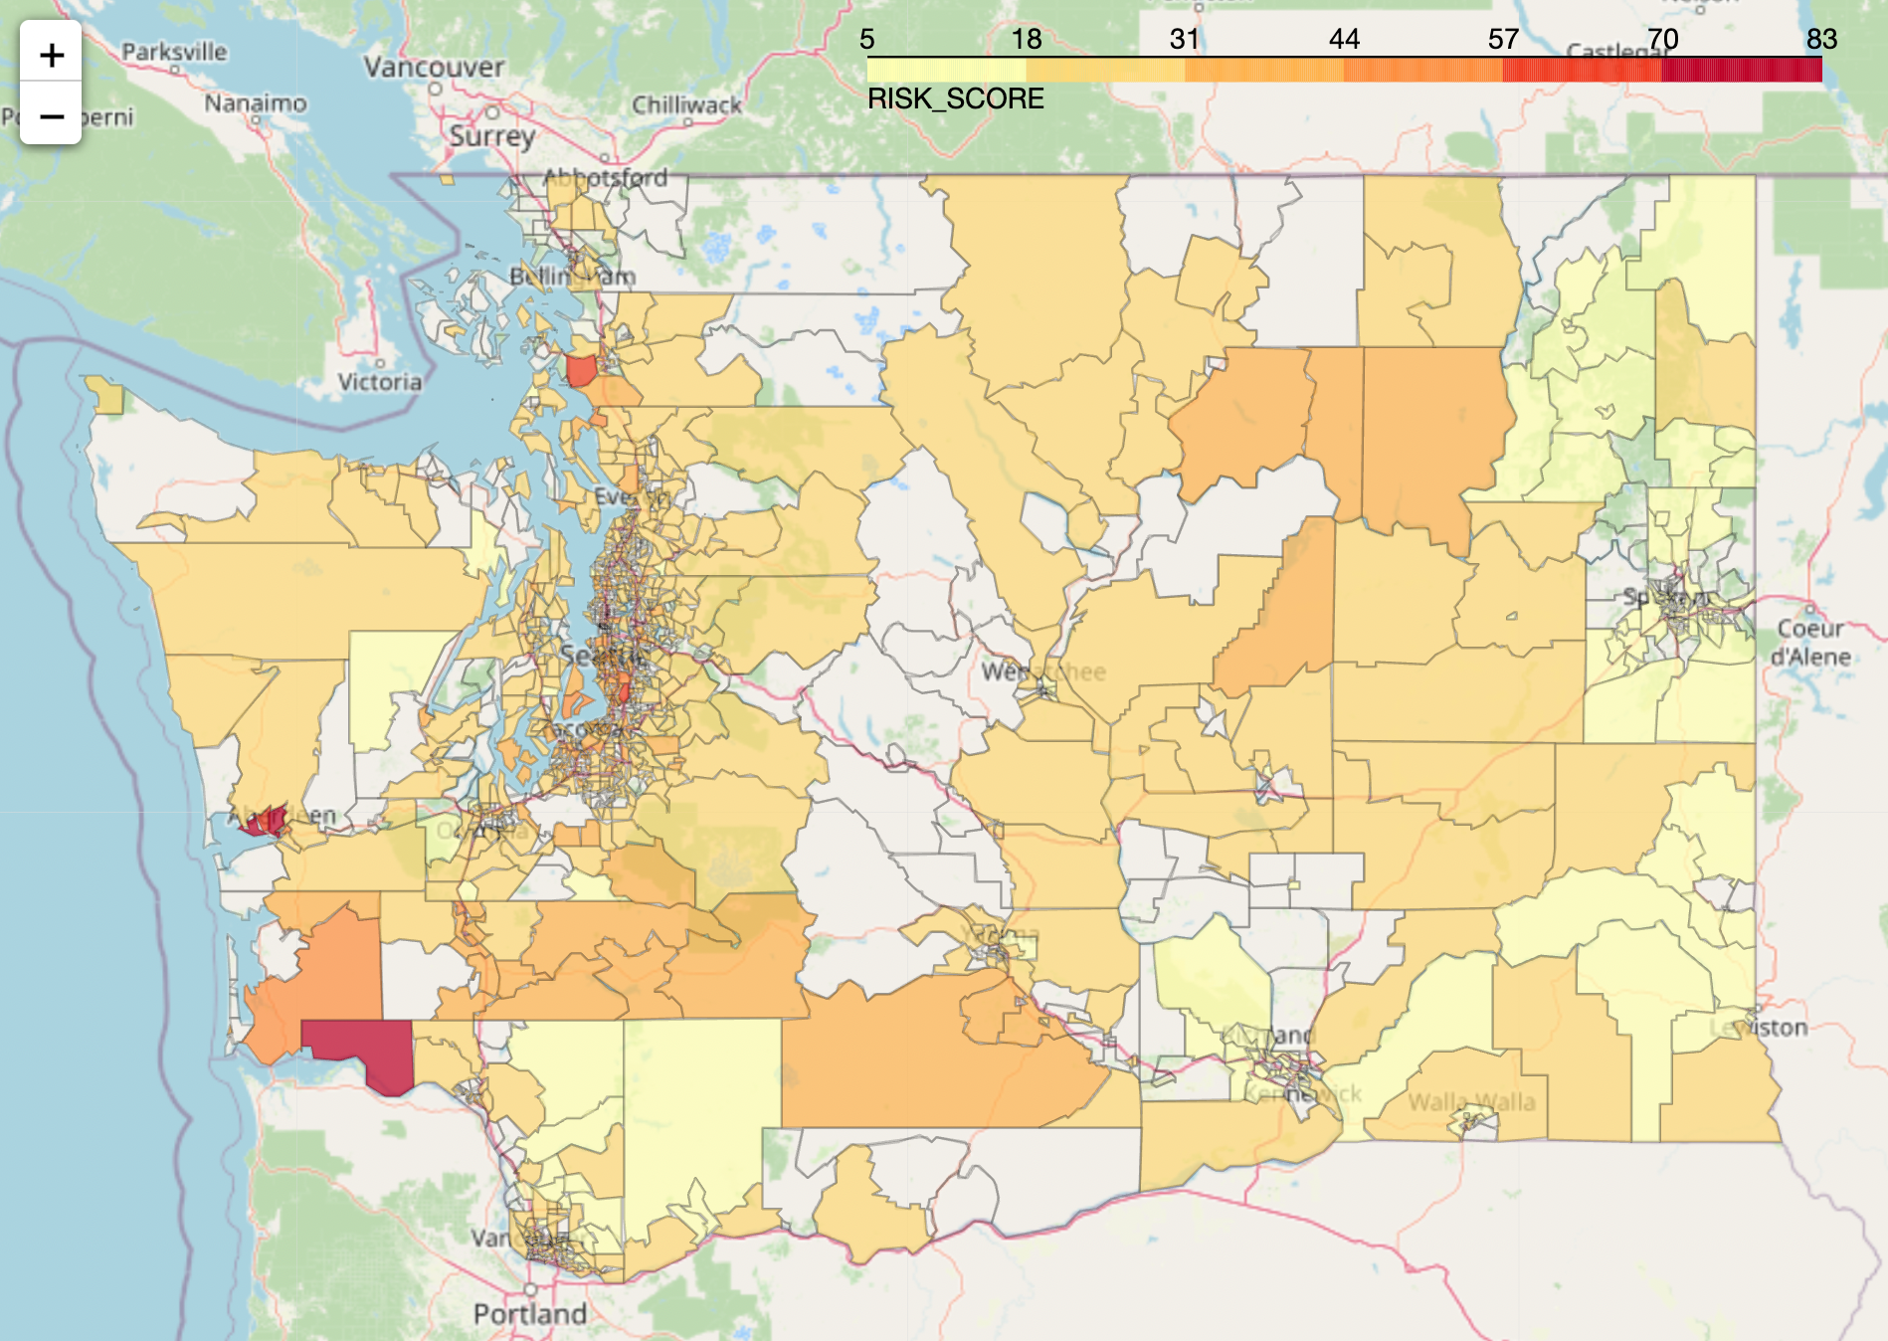
B. Natural Risk Index
Expected Annual Loss
X
Social Vulnerability
2
Community Resilience
Washington's most common natural disasters include wildfires, floods, severe storms, landslides, earthquakes, tsunamis, droughts, and volcanoes.
Natural Risk Index highly skewed by population, and property value.
Notes:
Washington's most common natural disasters include wildfires(WFIR), floods(CFLD: Coastal Flooding, RFLD: Riverine Flooding), severe storms(HRCN: Hurricane), landslides(LNDS), earthquakes(ERQK), tsunamis(TSUN), droughts(DRGT), and volcanoes(VLCN). Other less significant disasters include power outages, winter storms(CWAV: Cold Wave, WNTW: winter weather, ISTM: ice storm, HAIL: Hail, AVLN:Avalanche), and tornadoes(TRND). HWAV: Heat Wave
EAL: [Expected Annual Loss](https://hazards.fema.gov/nri/expected-annual-loss)
Expected Annual Loss (EAL) represents the average economic loss in dollars resulting from natural hazards each year. It is calculated for each hazard type and quantifies loss for relevant consequence types: buildings, people, and agriculture.
SOVI: [Social Vulnerability](https://hazards.fema.gov/nri/social-vulnerability) (Min-max normalized)
Social vulnerability is the susceptibility of social groups to the adverse impacts of natural hazards, including disproportionate death, injury, loss, or disruption of livelihood.
RESL: [Community Resilience](https://hazards.fema.gov/nri/community-resilience)
Community resilience is the ability of a community to prepare for anticipated natural hazards, adapt to changing conditions, and withstand and recover rapidly from disruptions.

Slide 8
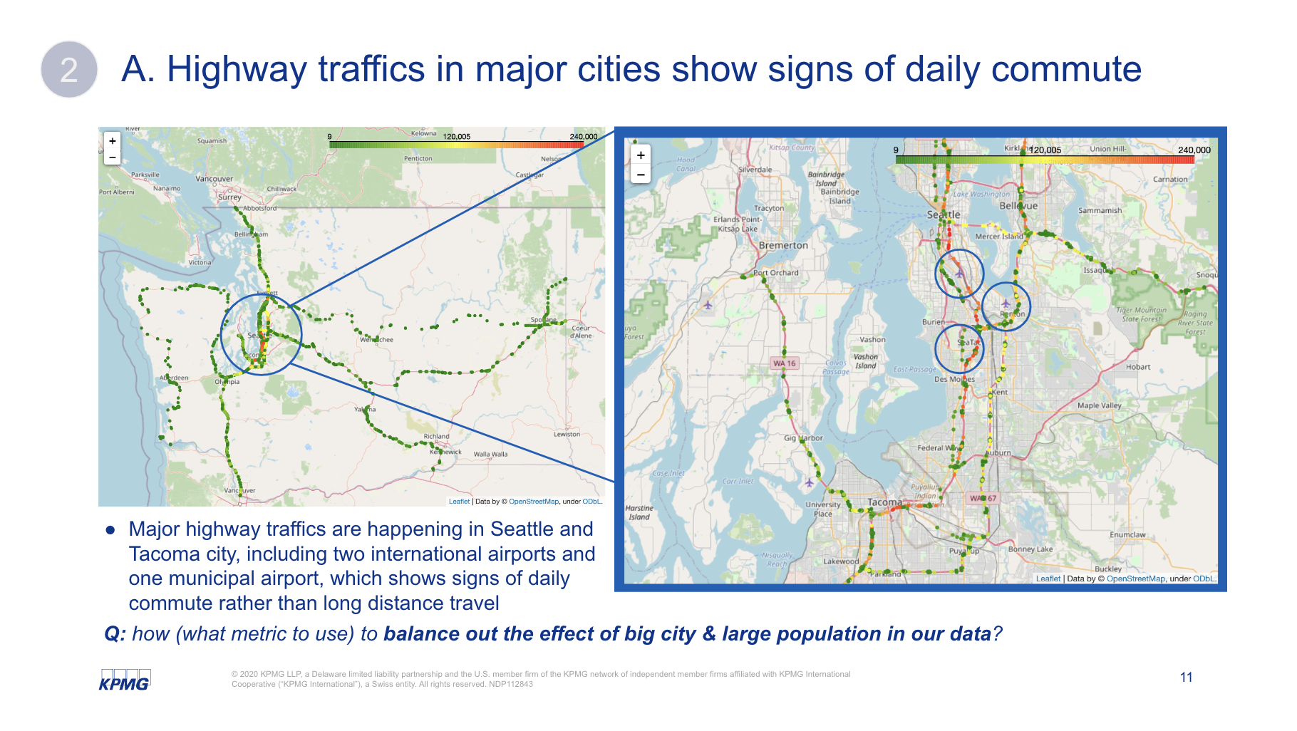
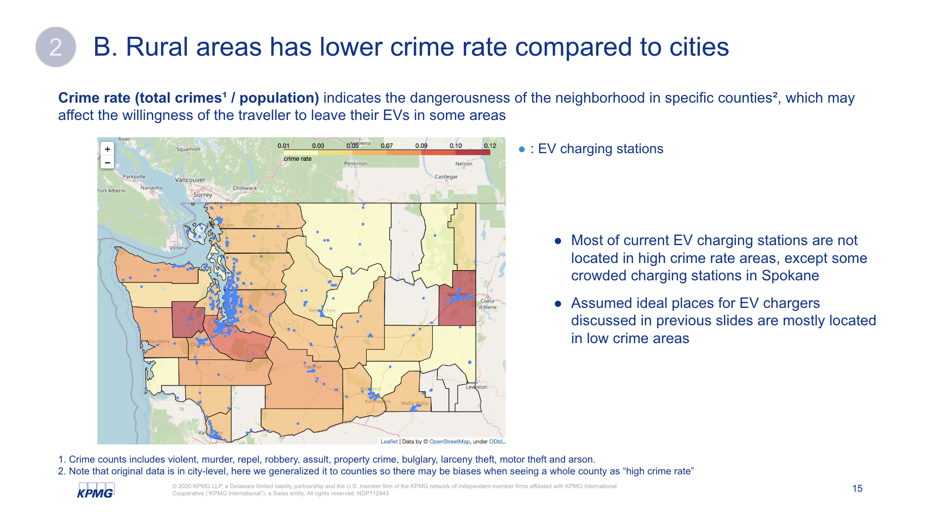
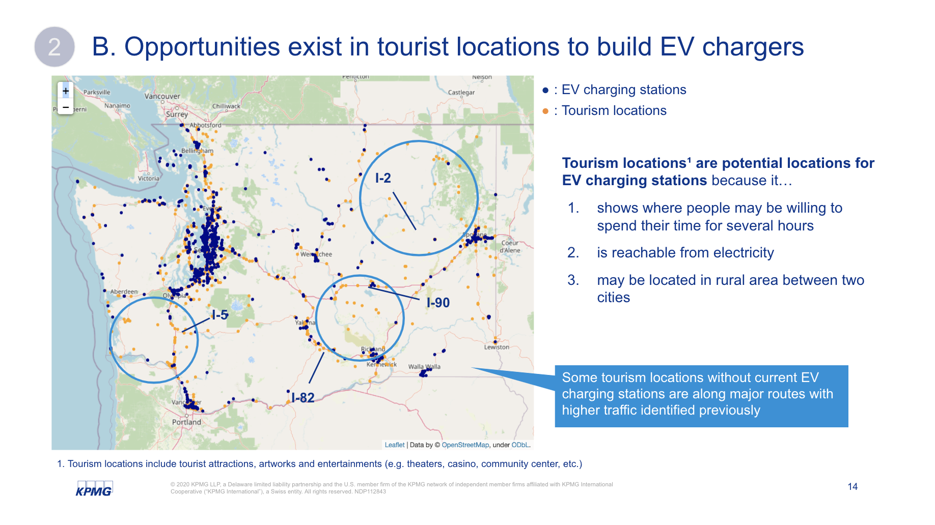
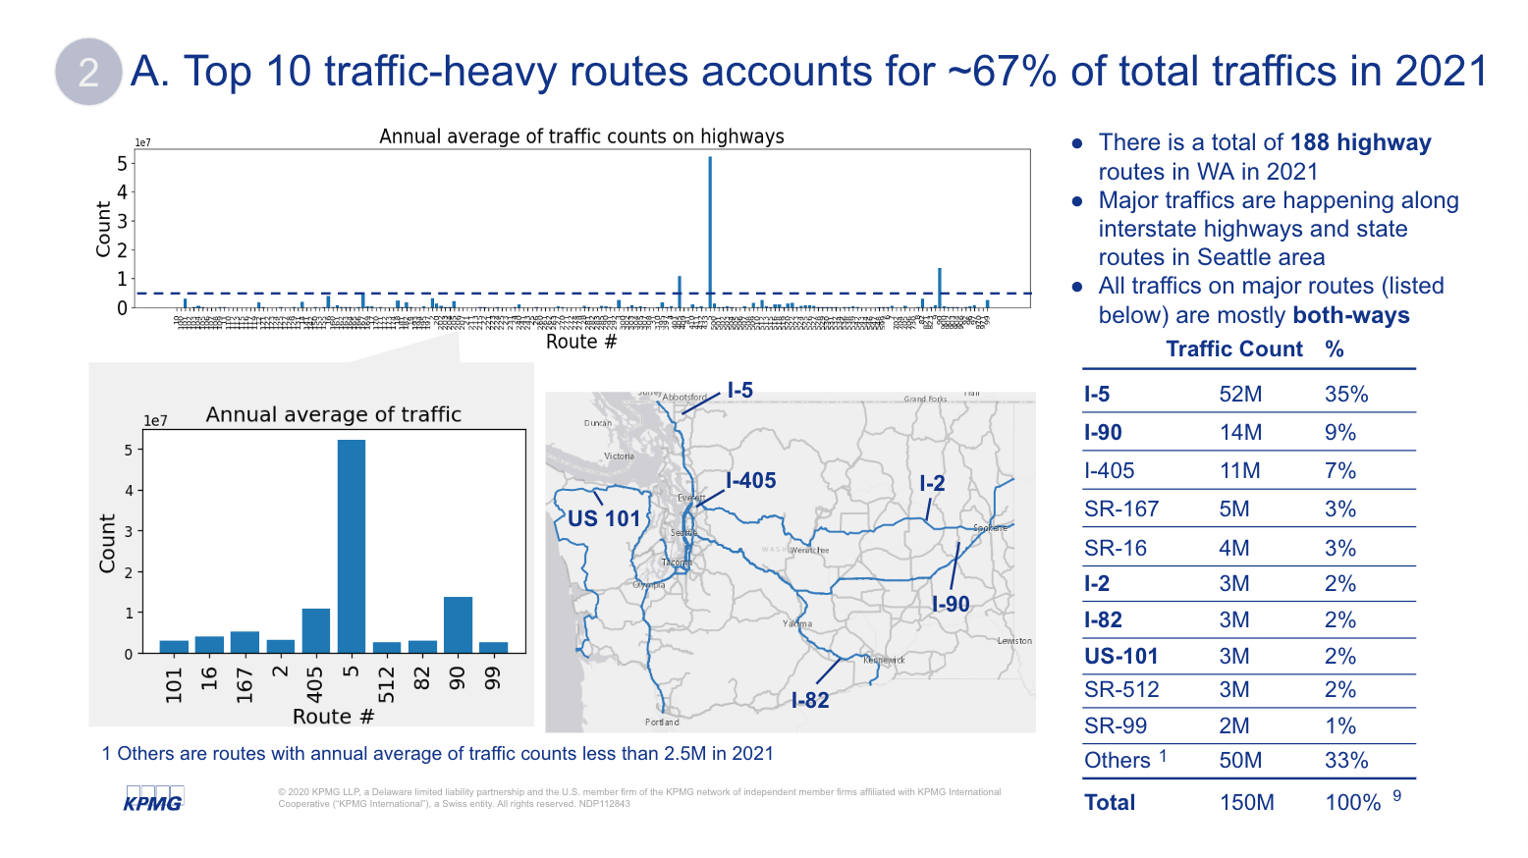
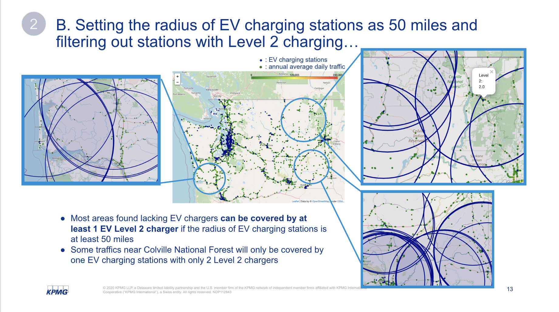
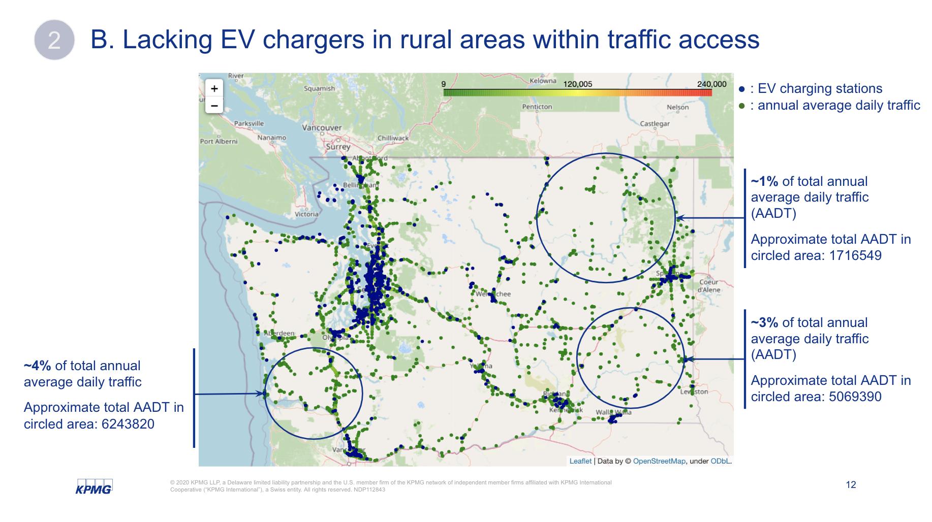
EDA: long-distance traveller perspective
3
Highway traffic reachability (main routes), tourism locations and crime rates are considerations that may affect the location of EV charging stations from the long distance traveller perspective
A
Highway traffic patterns
B
Current EV charging stations

Slide 9
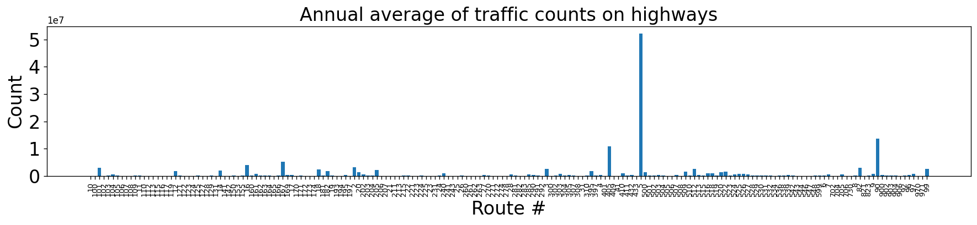
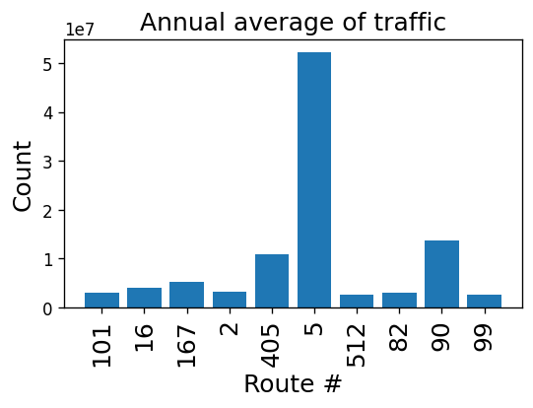
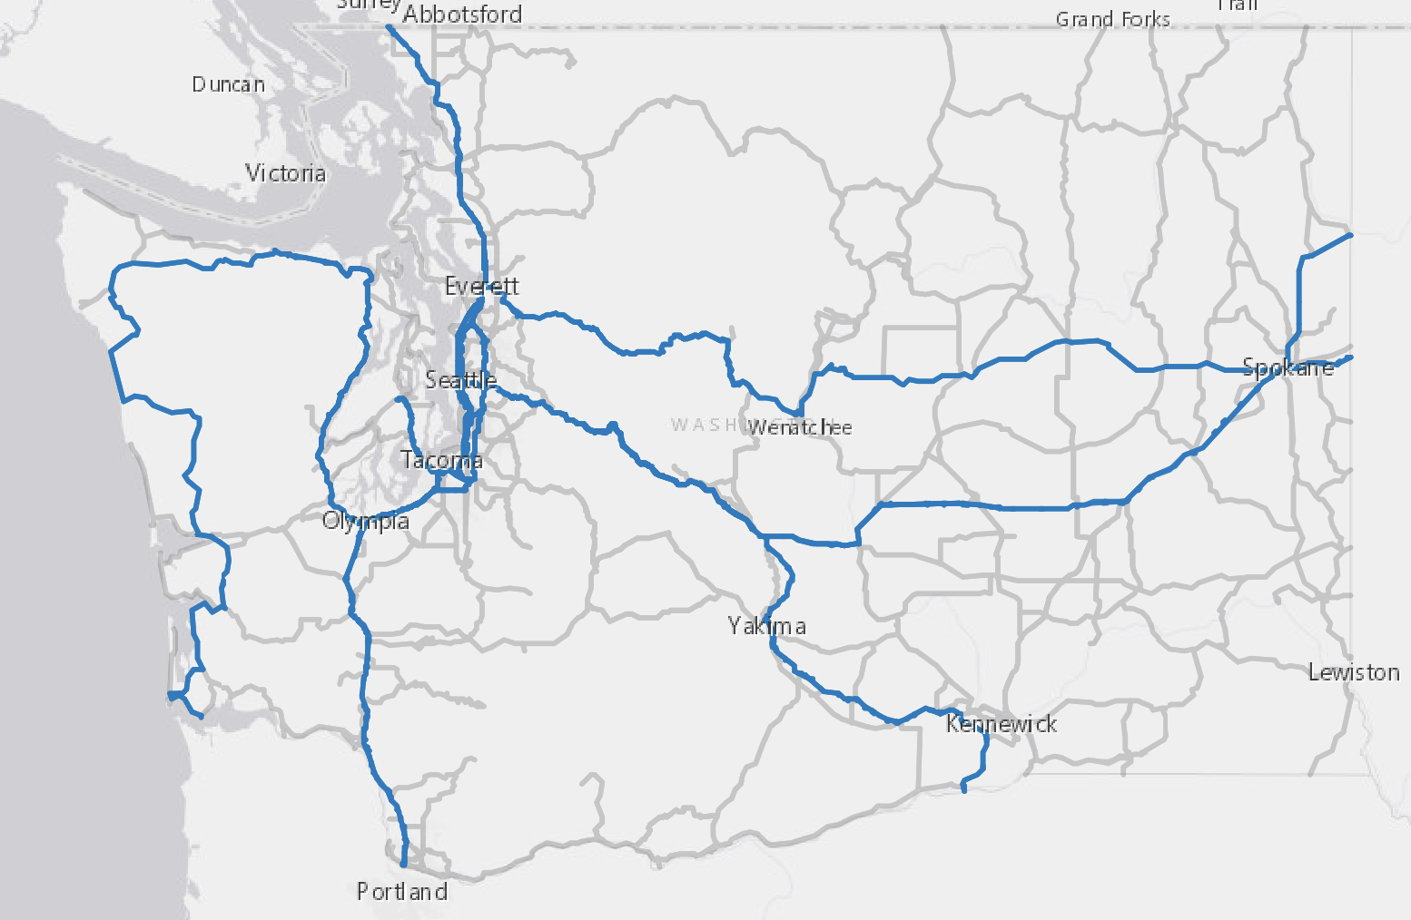
A. Top 10 traffic-heavy routes accounts for ~67% of total traffics in 2021
3
There is a total of 188 highway routes in WA in 2021
Major traffics are happening along interstate highways and state routes in Seattle area
All traffics on major routes (listed below) are mostly both-ways
Traffic Count
%
Top 10
I-5
52M
35%
I-5
I-90
14M
9%
I-405
I-2
I-405
11M
7%
US 101
SR-167
5M
3%
SR-16
4M
3%
I-2
3M
2%
I-90
I-82
3M
2%
I-5
US-101
3M
2%
I-82
SR-512
3M
2%
SR-99
2M
1%
1 Others are routes with annual average of traffic counts less than 2.5M in 2021
1
Others
50M
33%
Total
150M
100%
Notes:
Major traffics are happening along interstate highways and state routes in Seattle area
Summed up total traffic along the routes: top 10 account for 67%
1st is I-5: north-south faced and passes through seattle
2nd is I-90: east-west faced starting from seattle
Aiming to put EV charging stations along those routes

Slide 10
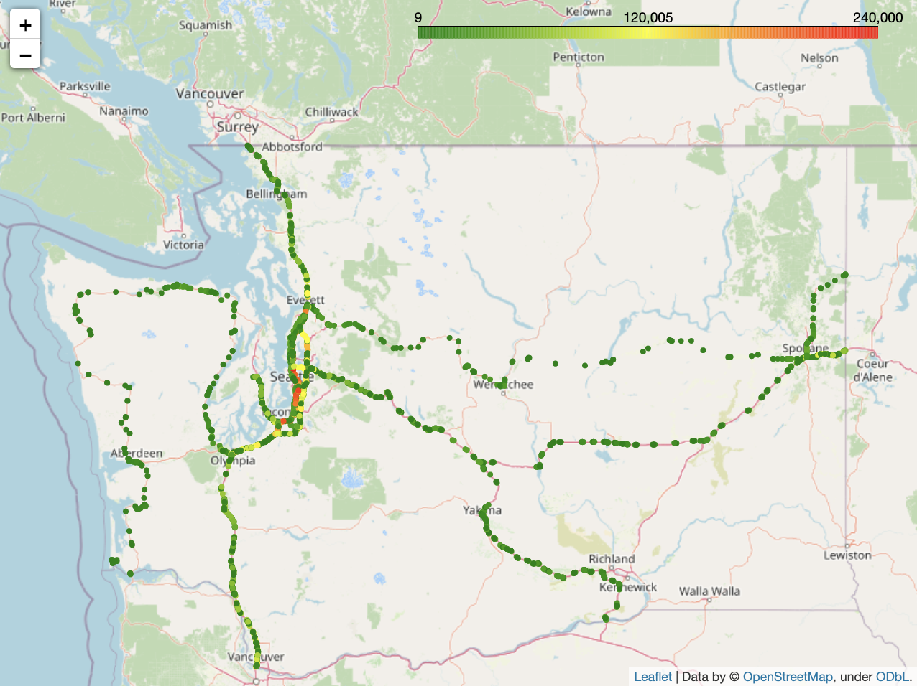
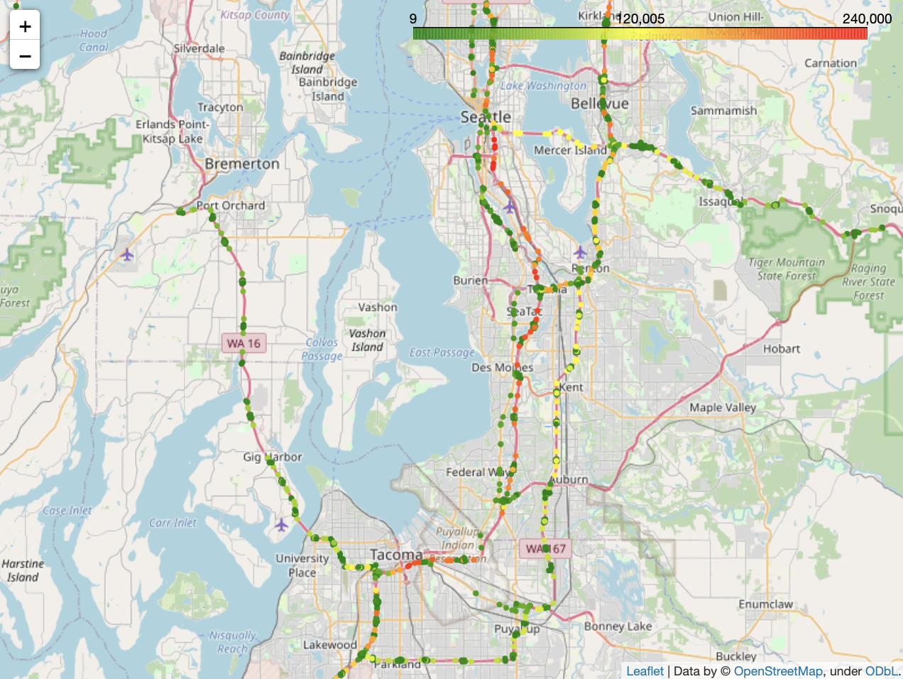
A. Highway traffics in major cities show patterns of daily commute
3
Major highway traffics are happening between Seattle and Tacoma city, including international airports and municipal airports, which shows a pattern of daily commute
Q: how (what metric to use) to balance out the effect of big city & large population in our data?
Notes:
major traffics happening in Seattle area
zoomed in: traffics happening between Tacoma & Seattle
3 airports in the heavy traffic area
-> shows daily commute -> how to down weight?
Edit suggestions: consider start & end point of the trip / direction of traffic

Slide 11
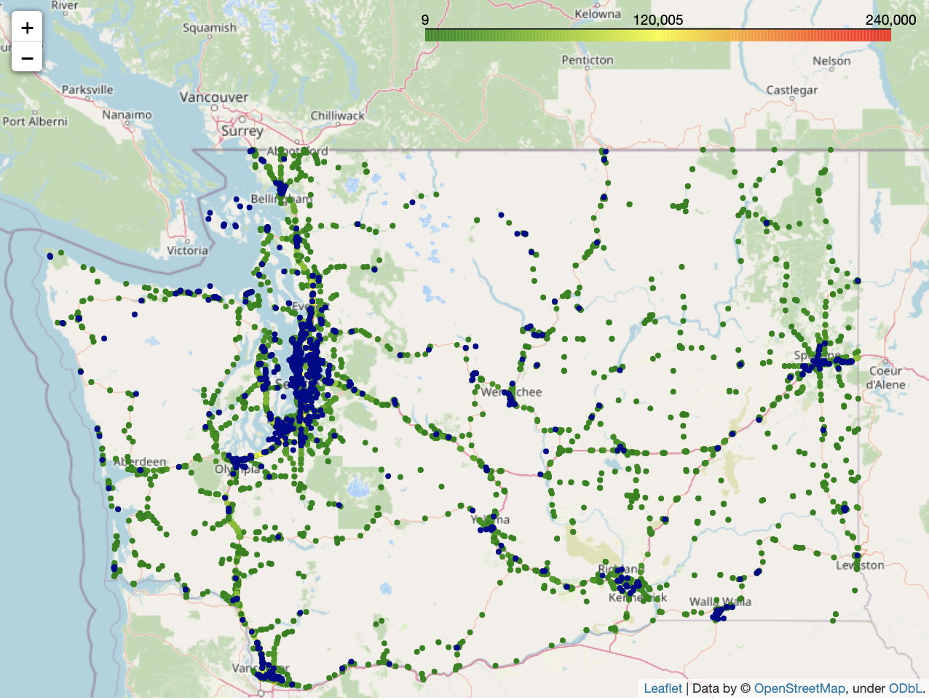
B. Lacking EV chargers in rural areas within traffic access
3
: EV charging stations
: annual average daily traffic
~1% of total annual average daily traffic (AADT)
Approximate total AADT in circled area: 1,716,549
~3% of total annual average daily traffic (AADT)
Approximate total AADT in circled area: 5,069,390
~4% of total annual average daily traffic
Approximate total AADT in circled area: 6,243,820
Notes:
plot ev stations along with traffic data, identified 3 areas with traffic but lacking EV chargers

Slide 12
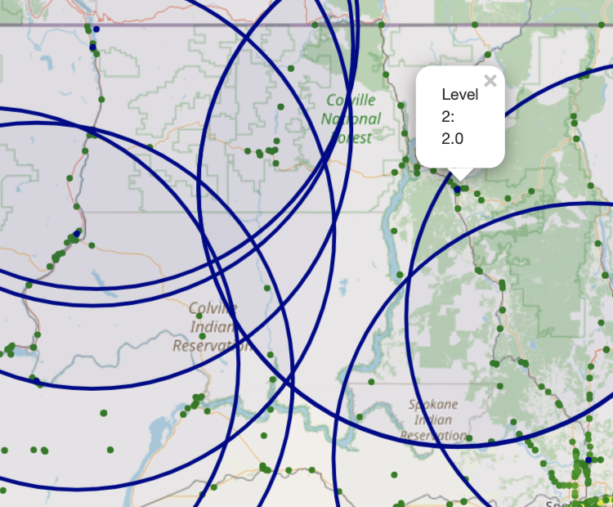
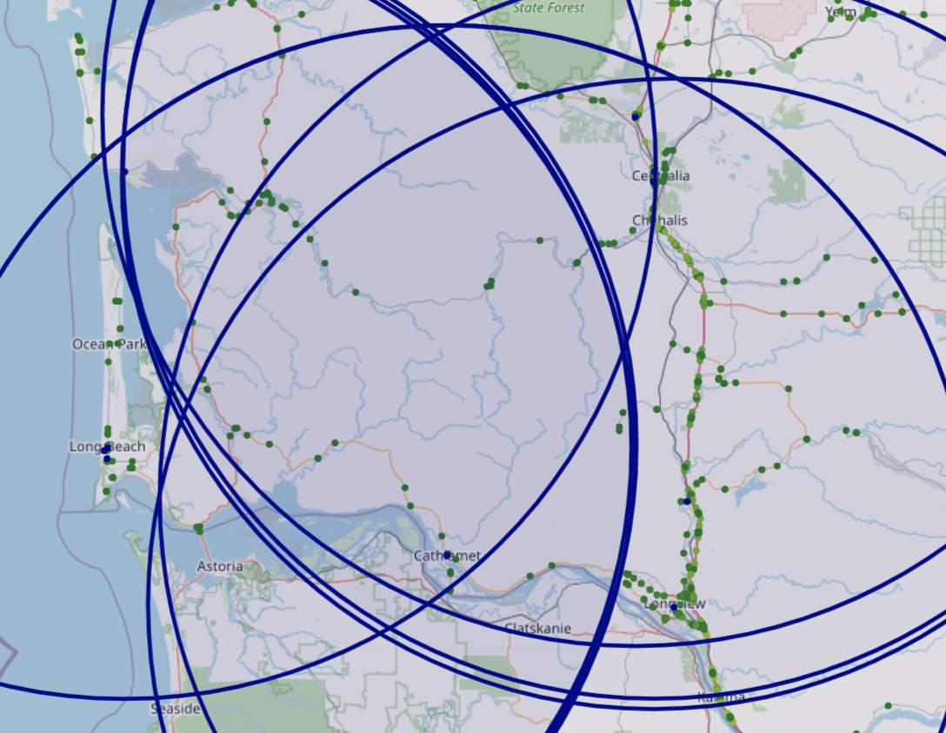
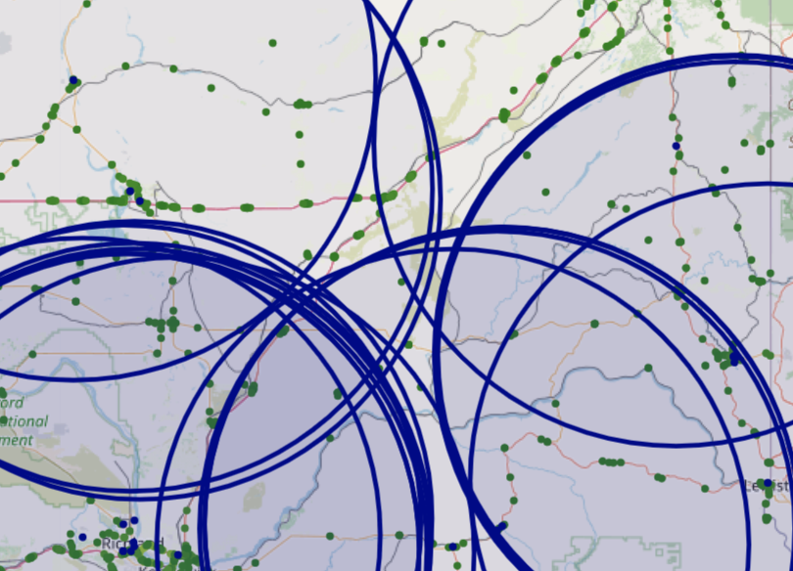
B. Setting the radius of EV charging stations as 50 miles and filtering out stations with Level 2 charging…
3
: EV charging stations
: annual average daily traffic
Most areas found lacking EV chargers can be covered by at least 1 EV Level 2 charger if the radius of EV charging stations is at least 50 miles
Some traffics near Colville National Forest will only be covered by one EV charging stations with only 2 Level 2 chargers

Slide 13
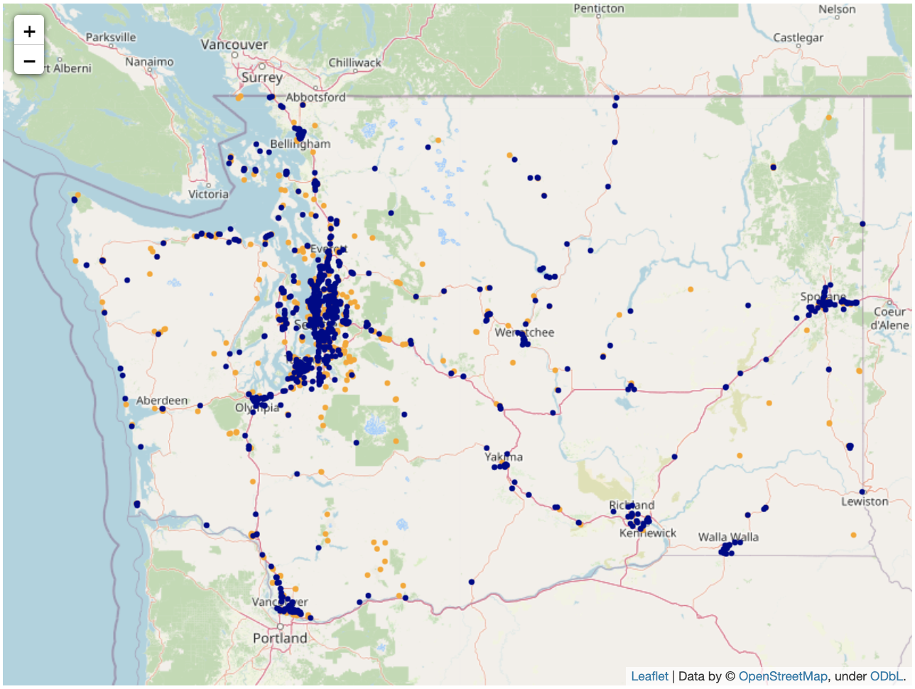
B. Opportunities exist to build EV chargers in tourism locations
3
: EV charging stations
: Tourism locations
Tourism locations¹ are potential locations for EV charging stations because it…
shows where people may be willing to spend their time for several hours
is reachable from electricity
may be located in rural area between two cities
Some tourism locations without current EV charging stations are along major routes (mainly I-5) with higher traffic identified previously
1. Tourism locations include tourist attractions, artworks and entertainments (e.g. theaters, casino, community center, etc.)

Slide 14
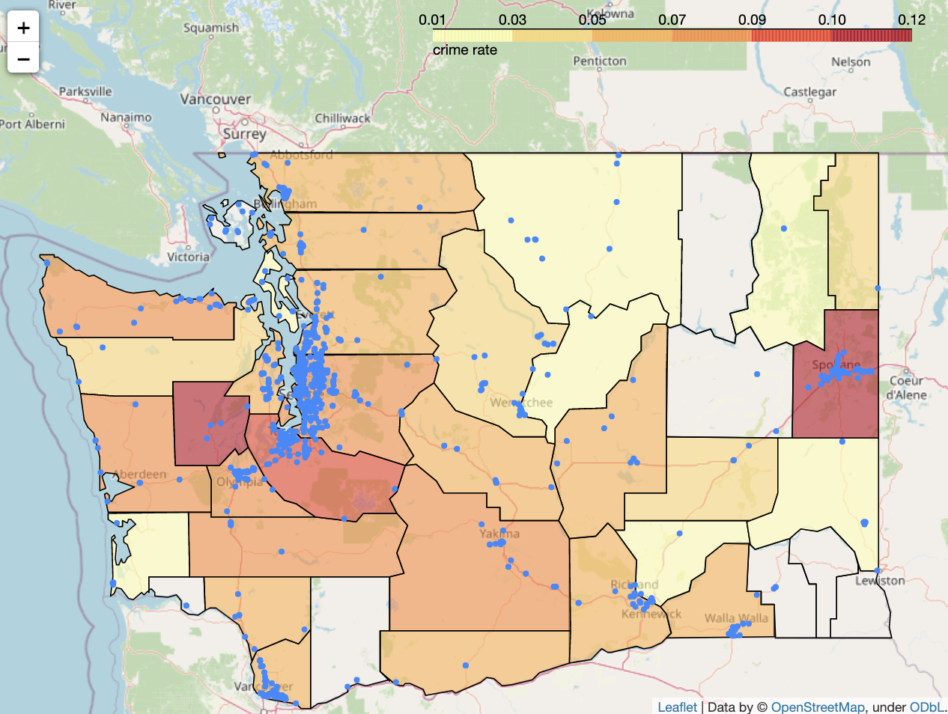
B. Rural areas has lower crime rate compared to cities
3
Crime rate (total crimes¹ / population) indicates the dangerousness of the neighborhood in specific counties², which may affect the willingness of the traveller to leave their EVs in some areas
: EV charging stations
Most of current EV charging stations are not located in high crime rate areas, except some crowded charging stations in Spokane
Assumed ideal places for EV chargers discussed in previous slides are mostly located in low crime areas
1. Crime counts includes violent, murder, repel, robbery, assult, property crime, bulglary, larceny theft, motor theft and arson.
2. Note that original data is in city-level, here we generalized it to counties so there may be biases when seeing a whole county as “high crime rate”

Slide 15
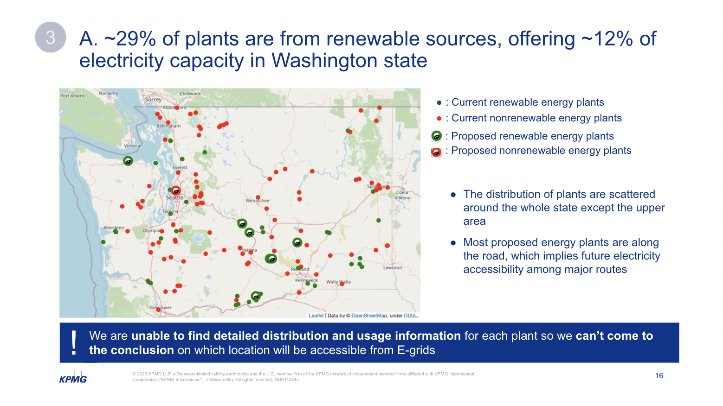
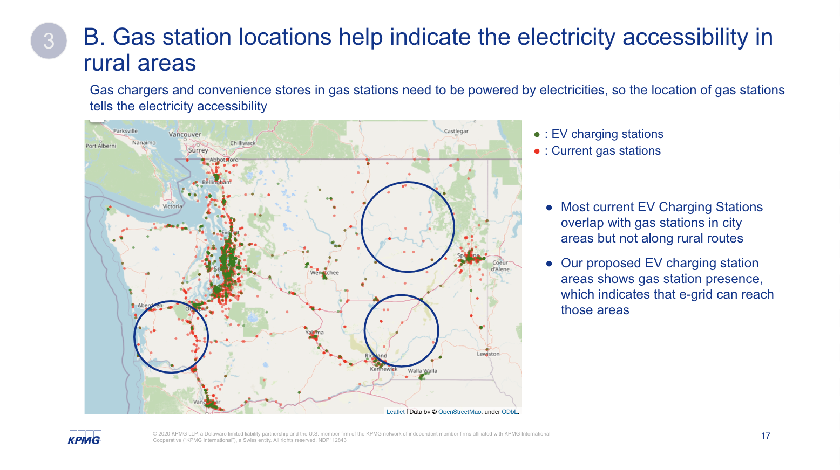
EDA: Existing infrastructure perspect
4
E-Grid capacity can constrain the distribution of EV stations; Gas station locations can be good reference points for the accessibility of electricity for rural EV charging locations
A
E-Grid
B
Gas station

Slide 16
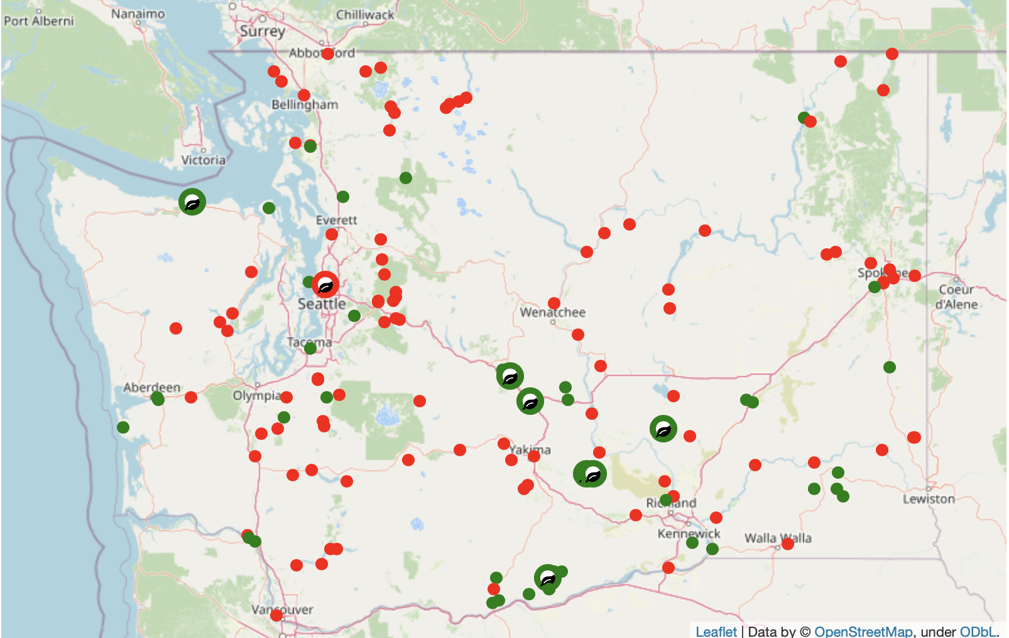


A. ~29% of plants are from renewable sources, offering ~12% of electricity capacity in Washington state
4
: Current renewable energy plants
: Current nonrenewable energy plants
: Proposed renewable energy plants
: Proposed nonrenewable energy plants
The distribution of plants are scattered around the whole state except the upper area
Most proposed energy plants are along the road, which implies future electricity accessibility among major routes
! !
We are unable to find detailed distribution and usage information for each plant so we can’t come to the conclusion on which location will be accessible from E-grids

Slide 17
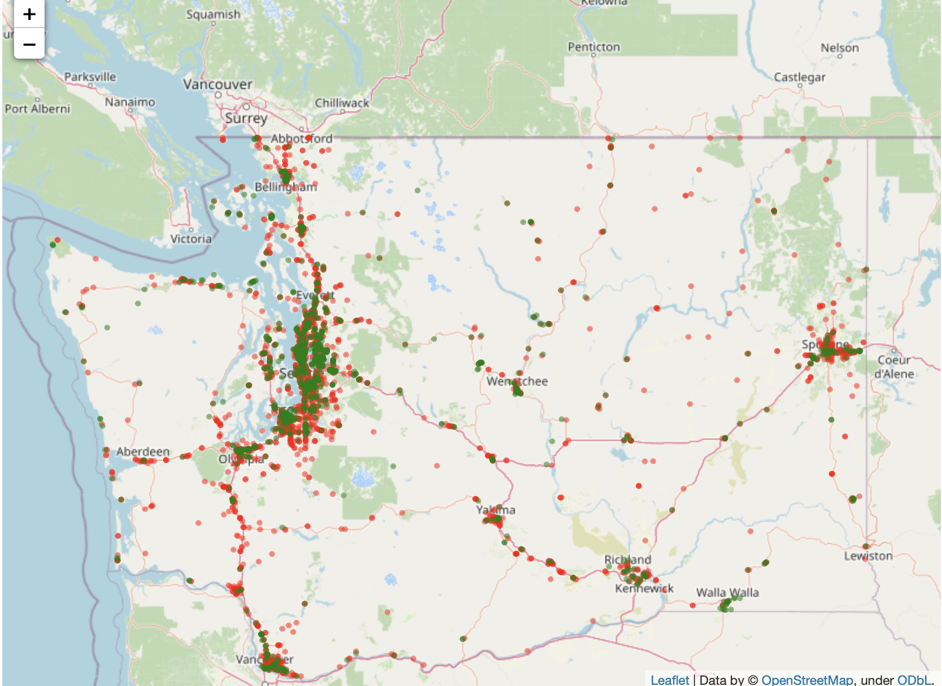
B. Gas station locations help indicate the electricity accessibility in rural areas
4
Gas chargers and convenience stores in gas stations need to be powered by electricities, so the location of gas stations tells the electricity accessibility
: EV charging stations
: Current gas stations
Most current EV Charging Stations overlap with gas stations in city areas but not along rural routes
Our proposed EV charging station areas shows gas station presence, which indicates that e-grid can reach those areas

Slide 18
Next Steps
5
Action items:
Finish up EDA for selected dataset
Consider metrics for feature engineering (data pre-processing for modeling)
Searching for potential models/algorithms
Start building quantitative objective functions

Slide 19
Appendix

Slide 20
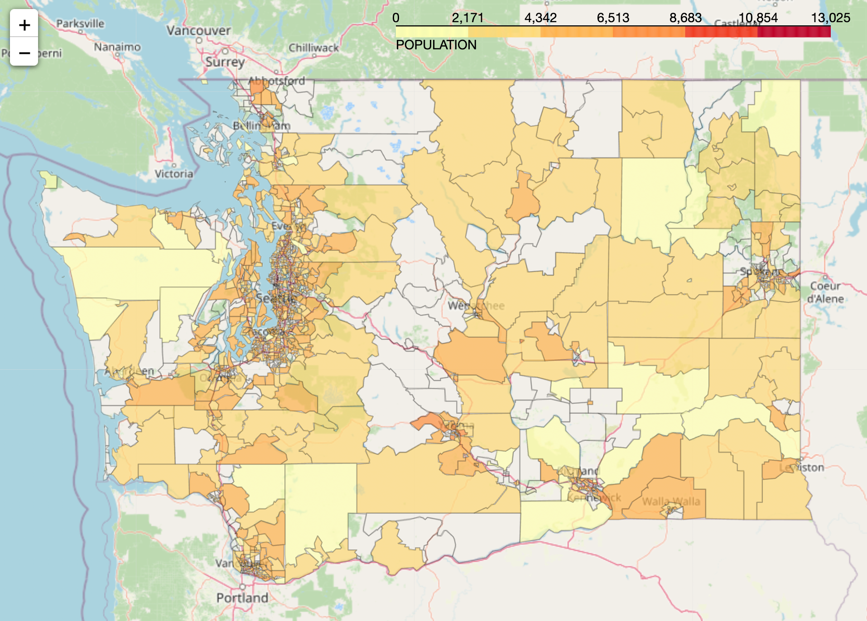
B. Population of each census tract
1
Notes:
Washington's most common natural disasters include wildfires(WFIR), floods(CFLD: Coastal Flooding, RFLD: Riverine Flooding), severe storms(HRCN: Hurricane), landslides(LNDS), earthquakes(ERQK), tsunamis(TSUN), droughts(DRGT), and volcanoes(VLCN). Other less significant disasters include power outages, winter storms(CWAV: Cold Wave, WNTW: winter weather, ISTM: ice storm, HAIL: Hail, AVLN:Avalanche), and tornadoes(TRND). HWAV: Heat Wave
EAL: [Expected Annual Loss](https://hazards.fema.gov/nri/expected-annual-loss)
Expected Annual Loss (EAL) represents the average economic loss in dollars resulting from natural hazards each year. It is calculated for each hazard type and quantifies loss for relevant consequence types: buildings, people, and agriculture.
SOVI: [Social Vulnerability](https://hazards.fema.gov/nri/social-vulnerability) (Min-max normalized)
Social vulnerability is the susceptibility of social groups to the adverse impacts of natural hazards, including disproportionate death, injury, loss, or disruption of livelihood.
RESL: [Community Resilience](https://hazards.fema.gov/nri/community-resilience)
Community resilience is the ability of a community to prepare for anticipated natural hazards, adapt to changing conditions, and withstand and recover rapidly from disruptions.

Slide 21
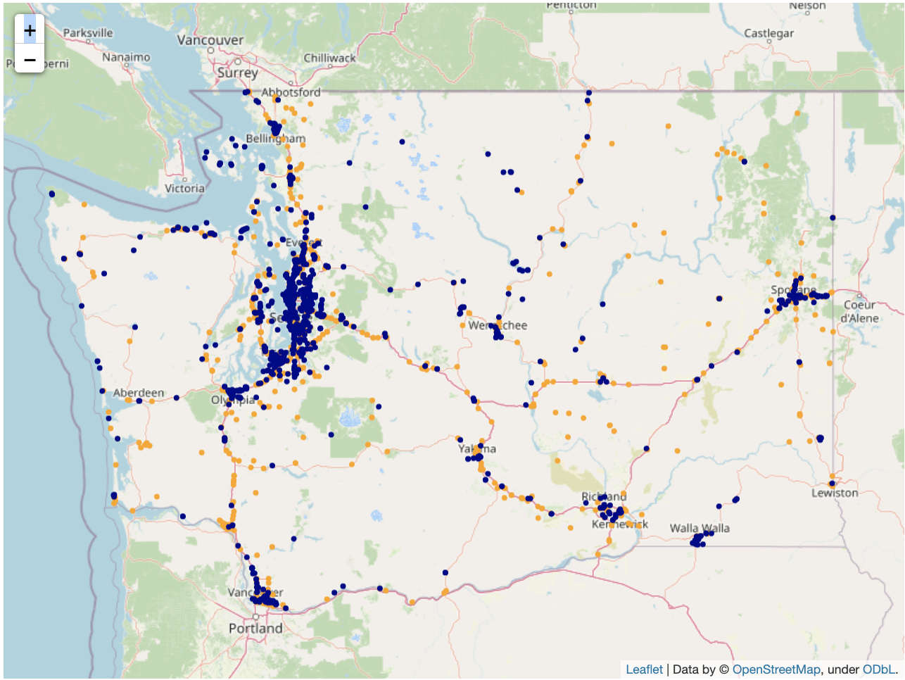
B. Opportunities exist to build EV chargers in tourism locations
3
: EV charging stations
: Tourism locations
Tourism locations¹ are potential locations for EV charging stations because it…
shows where people may be willing to spend their time for several hours
is reachable from electricity
may be located in rural area between two cities
I-2
I-90
I-5
Some tourism locations without current EV charging stations are along major routes with higher traffic identified previously
I-82
1. Tourism locations include tourist attractions, artworks and entertainments (e.g. theaters, casino, community center, etc.)

Slide 22
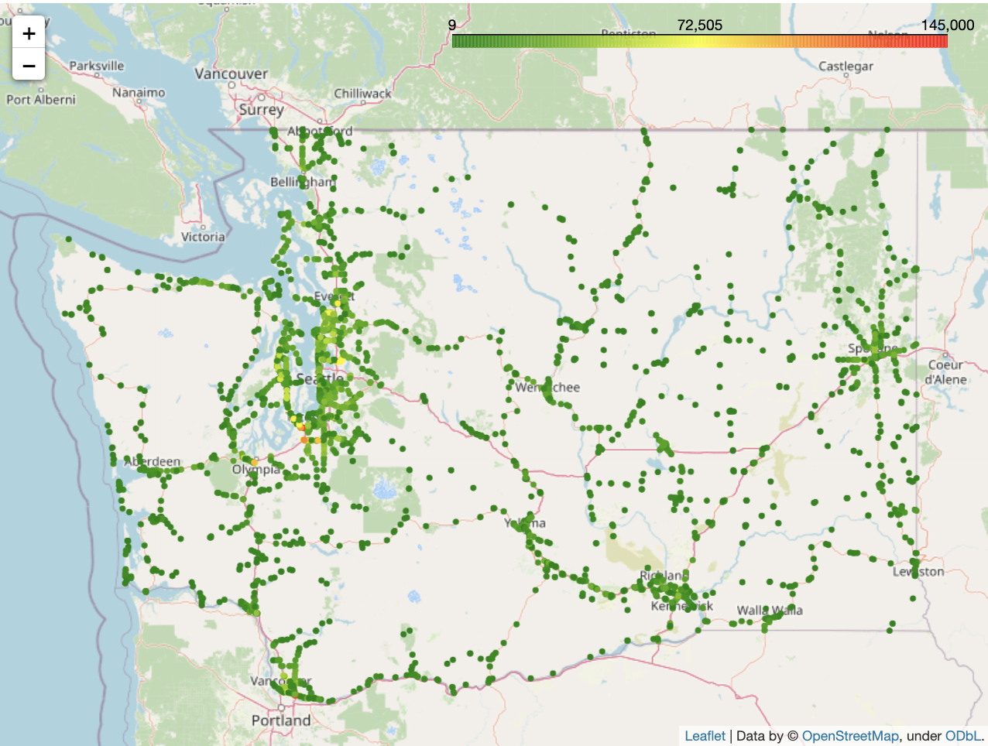
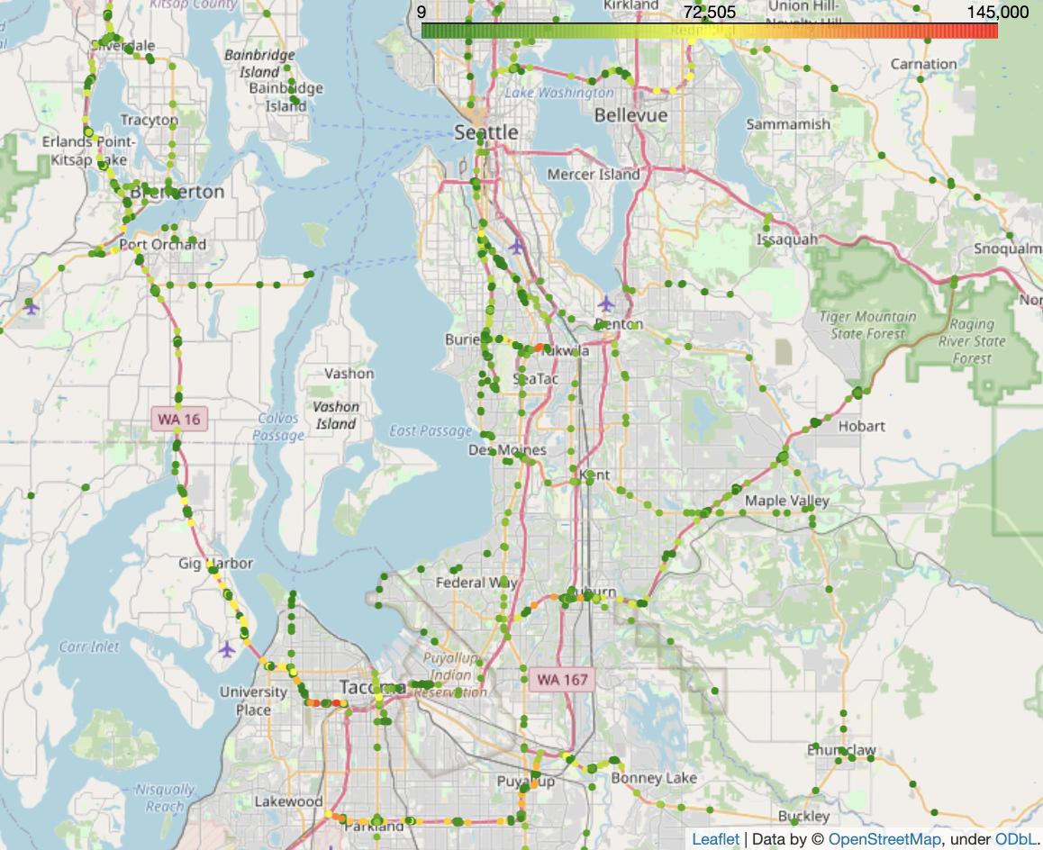
A. Remaining 45% of highway traffics are crowded around major cities
2
Highway traffic in large cities sometimes implies daily commute (?)

Slide 23
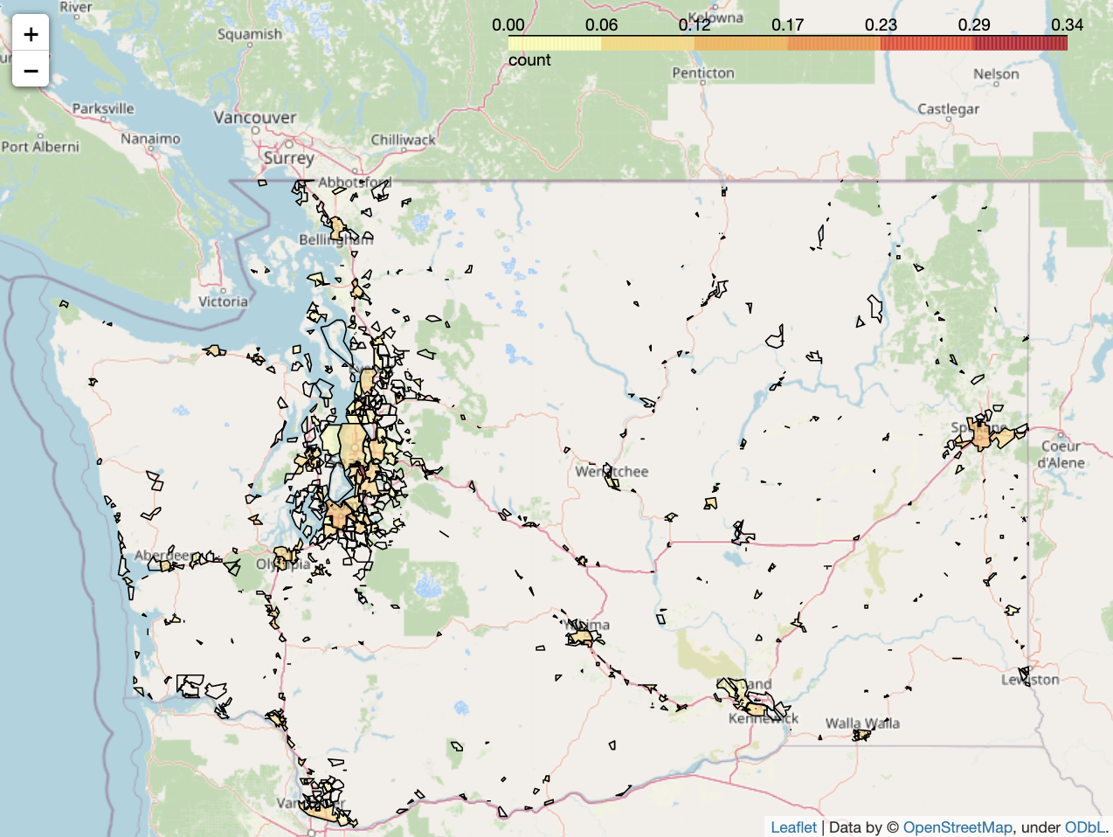

C. Crime rate by city
2
: EV charging stations

Slide 24
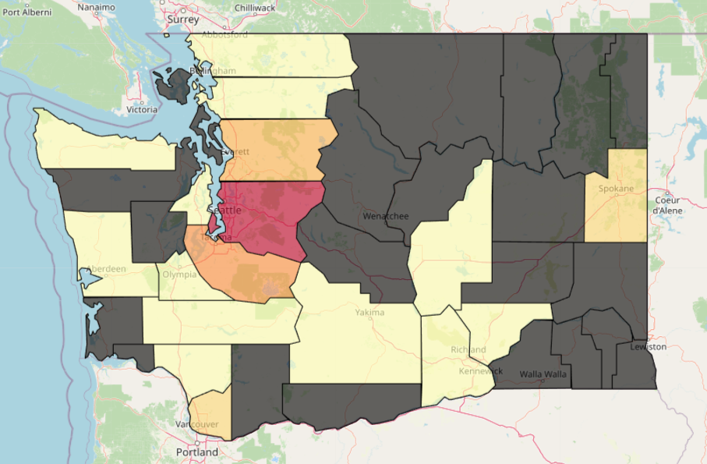
Commute Perspective
Travel time to work by County
Too much missing data
Does not give useful commute information about rural area
Daytime VS Nighttime population
Cannot find recent data
The most recent data can be found on ACS is in year 2018
Notes:
Too many missing data with regard to the “travel time to work by county” perspective that we think we just cannot use this data for optimization purpose.
There are not recent data for “Daytime VS Nighttime population”, and the most recent data can be found is in year 2018, which is too old for us to consider for recent circumstances.

